Slide 1









PLANTS VS ZOMBIE: GOLDEN SPATULA

Slide 2


Slide 3
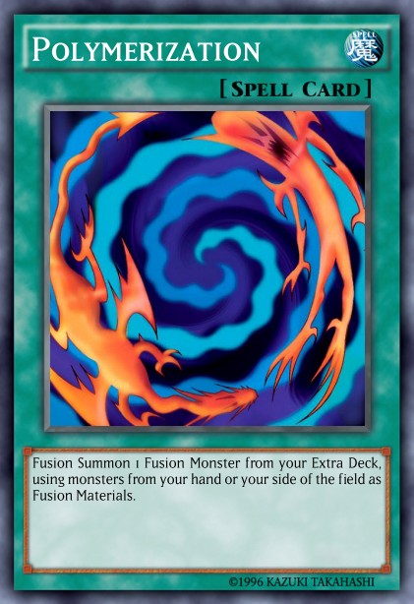

Slide 4


Slide 5

HOW TO PLAY OUR GAME?

Slide 6
WHAT CHARACTERS WE USE?

Slide 7





Slide 8







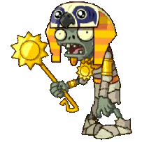

Slide 9


HOW IS THE CODE ORGANIZED?

Slide 10
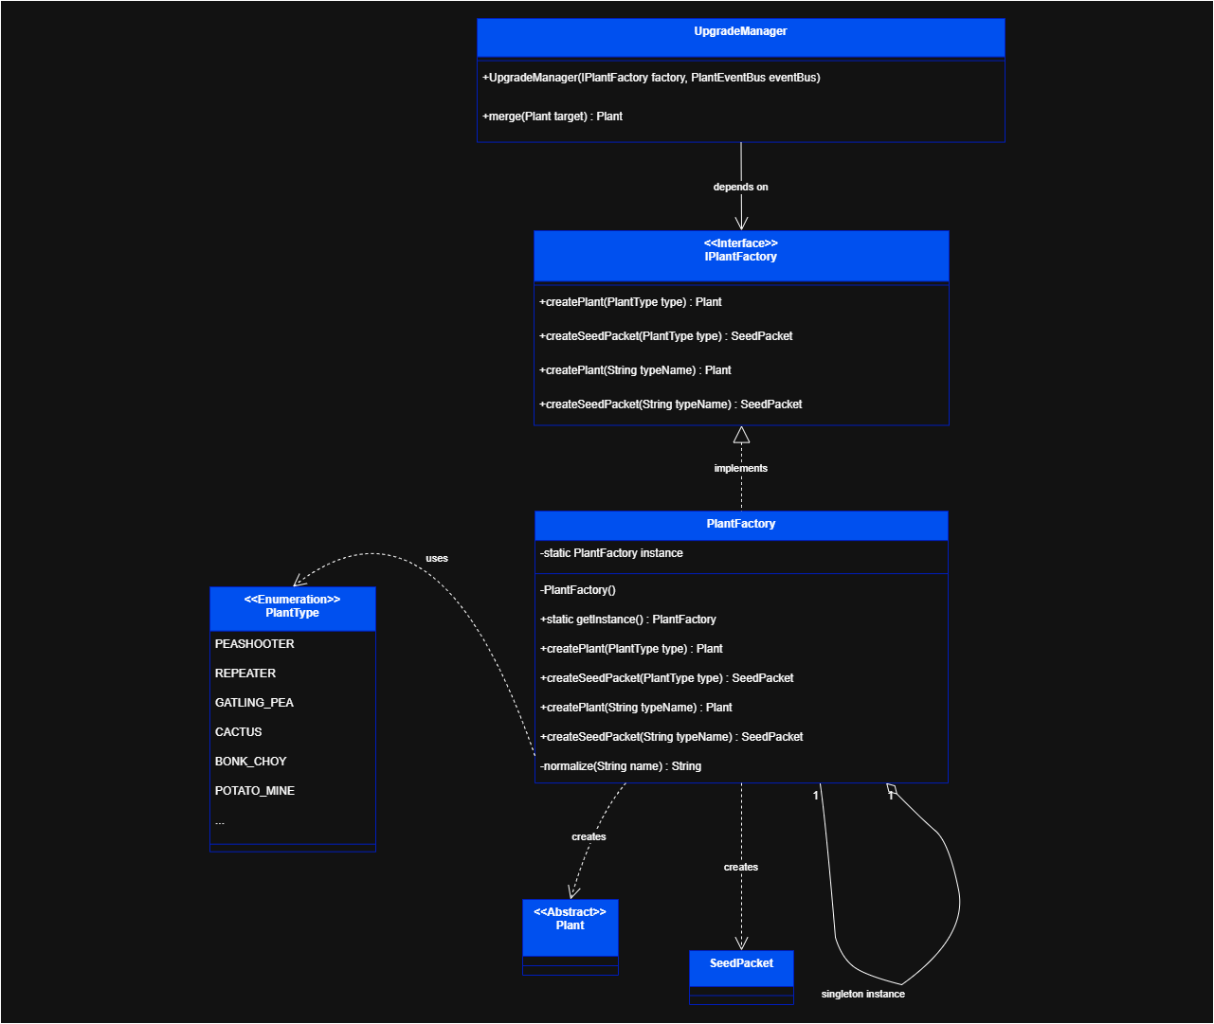
FACTORY METHOD
  Key Classes: PlantFactory, ZombieFactory
  The Problem: Rigid code. WaveManager becomes too complex by handling specific details for every unit type.
  The Solution: Use an interface. The manager requests a type; the factory handles the setup.
  The Benefit: Open/Closed Principle. Add new plants or zombies without changing existing game logic.

Slide 11
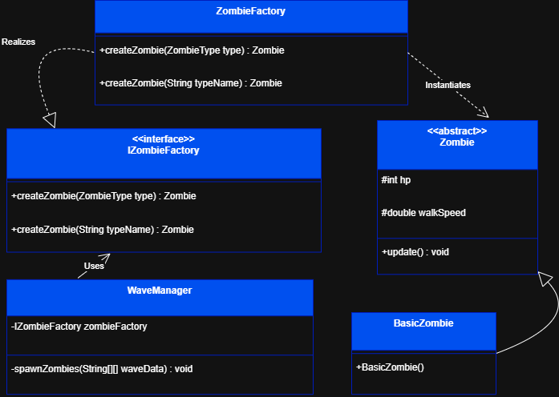
FACTORY METHOD

Slide 12
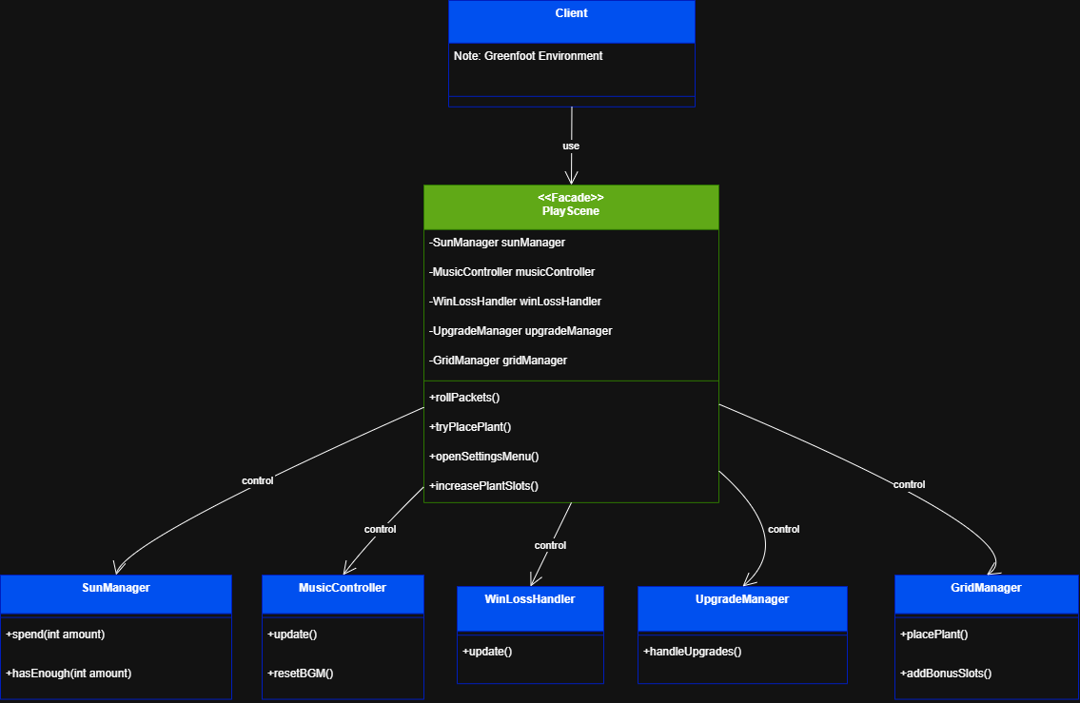
FACADE PATTERN
  The Hub: PlayScene class
  The Problem: "Spaghetti Code." Too many links between SunManager, GridManager, and MusicController.
  The Solution: A central control center. Subsystems are triggered through one method: tryPlacePlant().
  The Benefit: Decoupling. Update the grid or sun mechanics without breaking the input system.

Slide 13
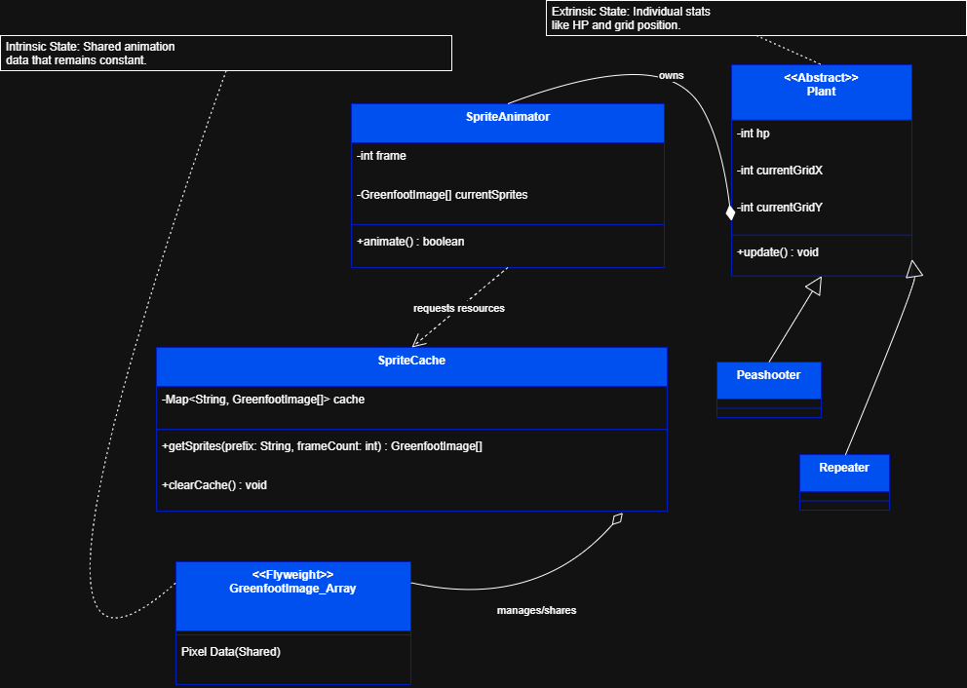
FLYWEIGHT PATTERN
  The Tool: SpriteCache
  The Problem: High RAM usage. Loading unique images for every single zombie would crash the game.
  The Solution: Shared assets. Units point to a single reference of a texture in memory.
  The Benefit: High Performance. Allows dozens of units on screen simultaneously with minimal memory footprint.

Slide 14
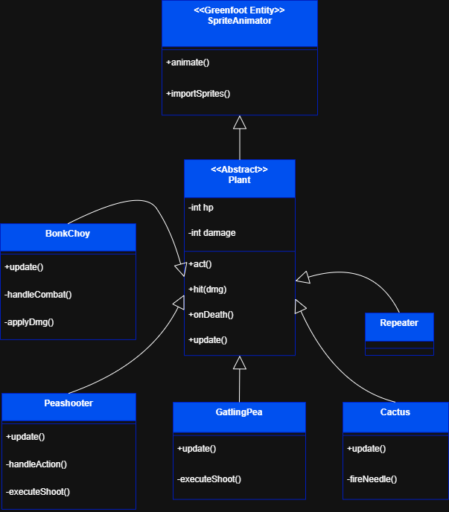
TEMPLATE METHOD
  Base Classes: Plant & Zombie
  The Problem: Redundant code. All units share a life cycle (Spawn →→ Fight →→ Die) but act differently.
  The Solution: Define a fixed structure in the base class; let subclasses (e.g., BonkChoy) fill in the unique details.
  The Benefit: Centralized Logic. Shared features like HP bars are managed in one place, making global updates easy.

Slide 15
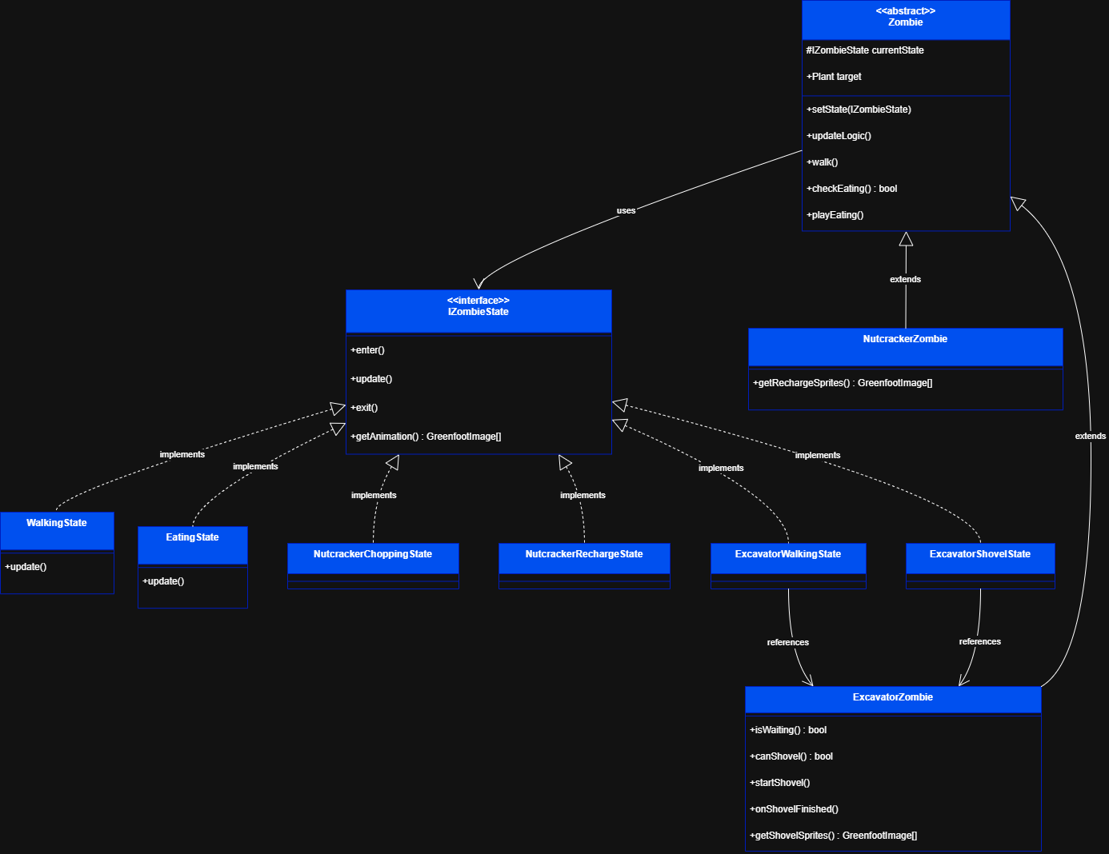
STATE PATTERN

Slide 16
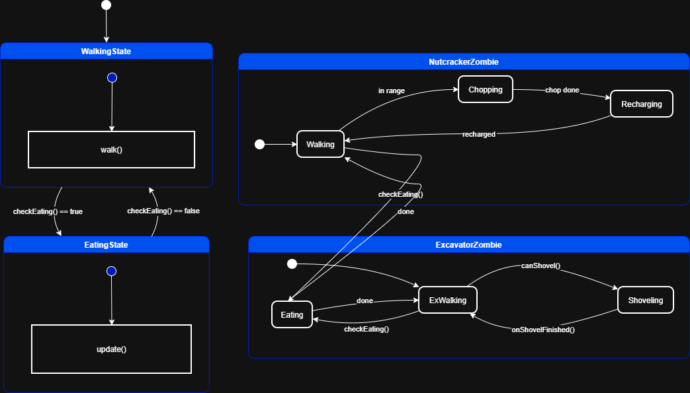
STATE PATTERN

Slide 17
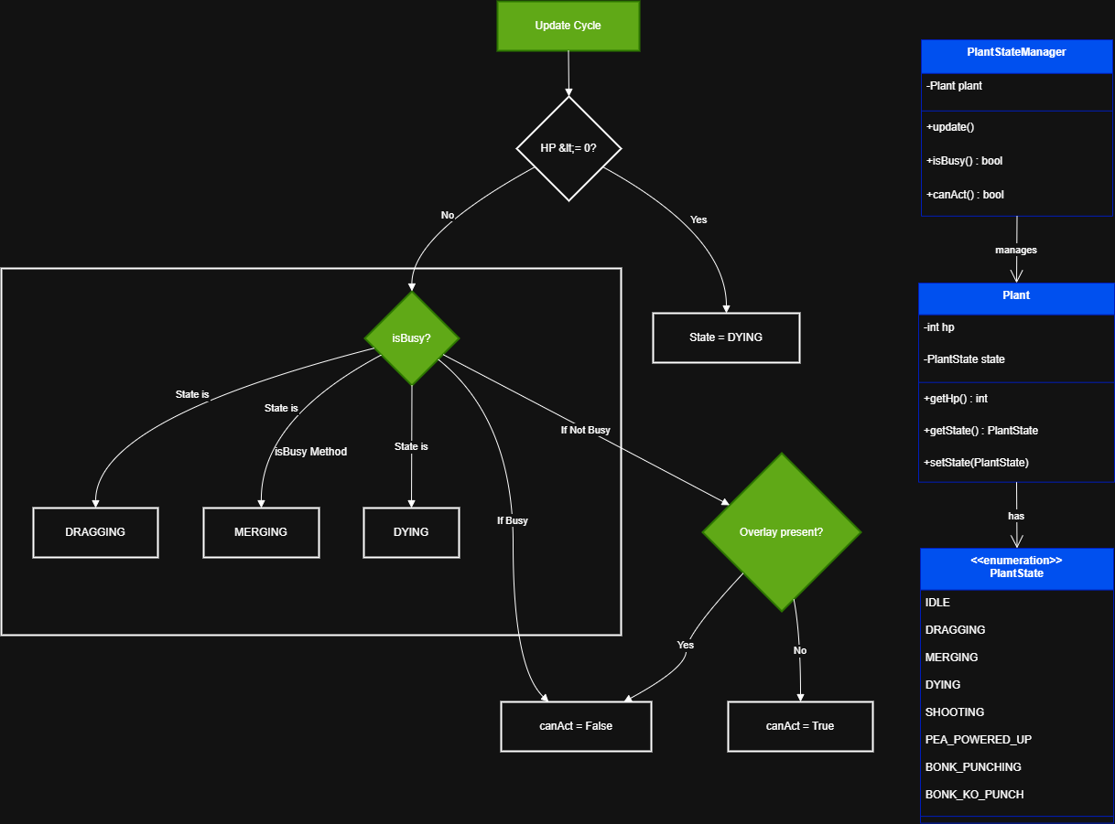
STATE PATTERN

Slide 18
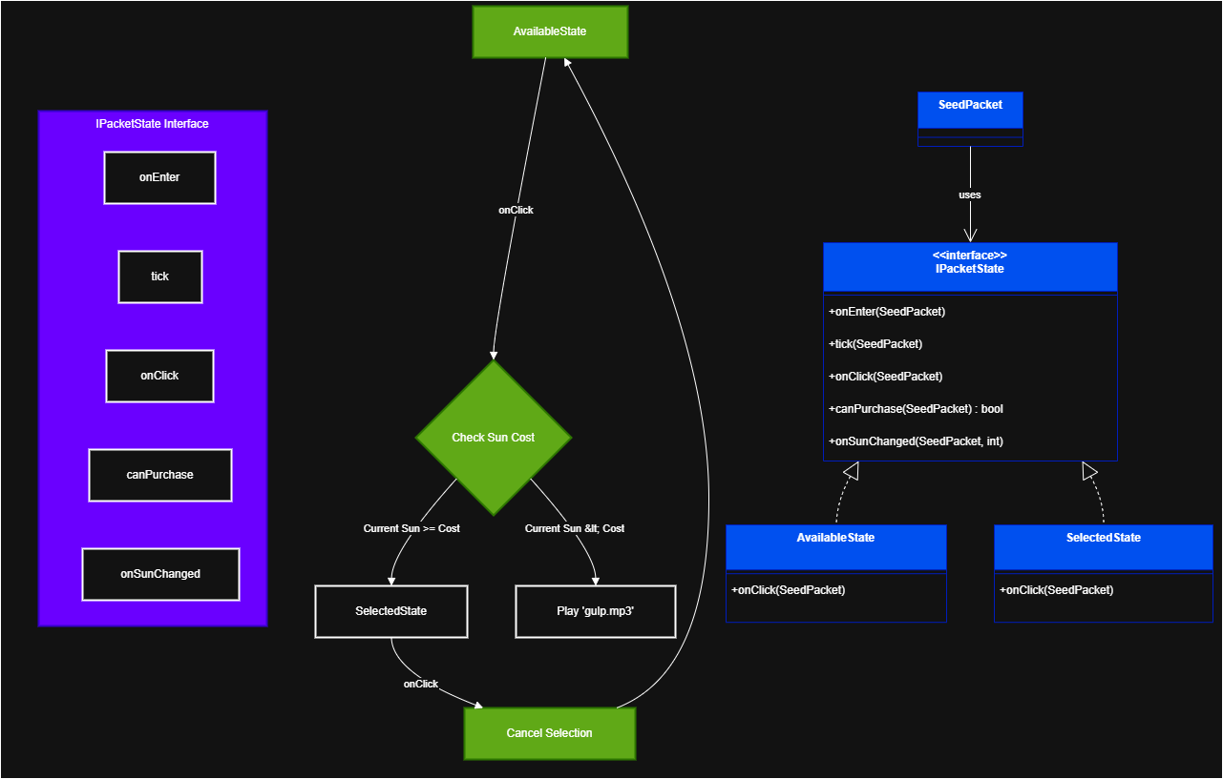
STATE PATTERN

Slide 19
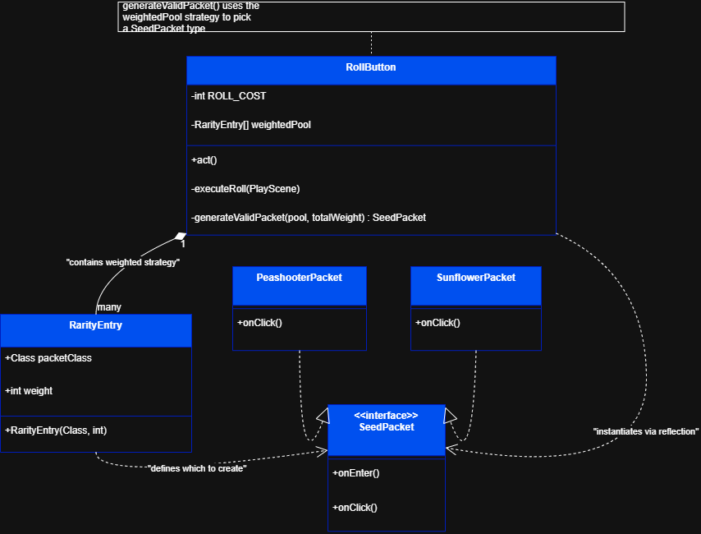
STRATEGY PATTERN

Slide 20
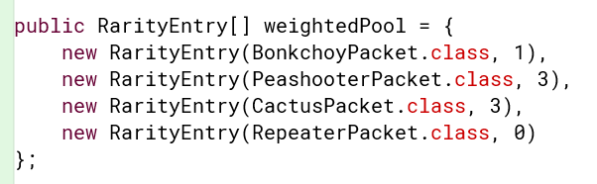
STRATEGY PATTERN

Slide 21
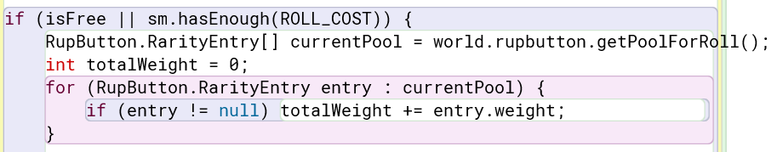
STRATEGY PATTERN

Slide 22
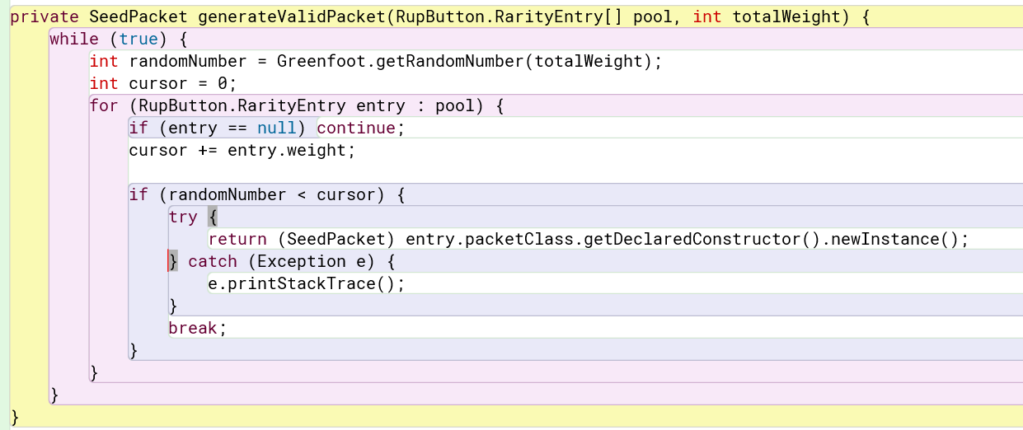
STRATEGY PATTERN

Slide 23
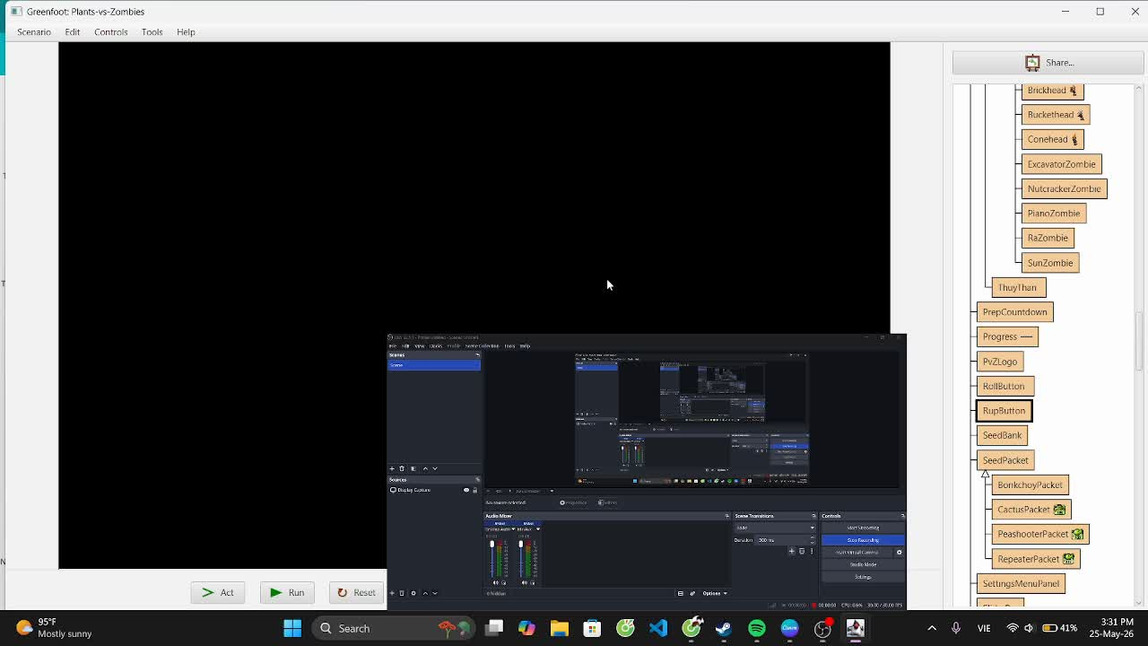

Slide 24
COMMAND PATTERN
1. COMMAND (THE INTERFACE)
2. CONCRETE COMMAND (SPECIFIC IMPLEMENTATIONS)
3. INVOKER (THE TRIGGER/CONTROLLER)
4. RECEIVER (THE TARGET OF ACTION)

Slide 25
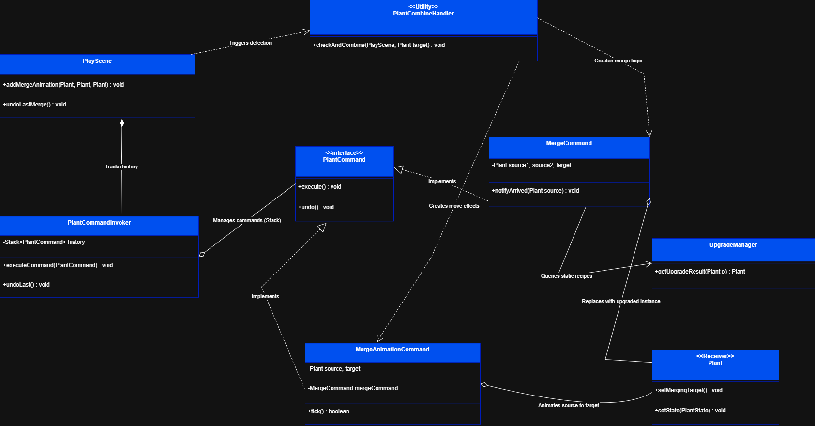
COMMAND PATTERN

Slide 26
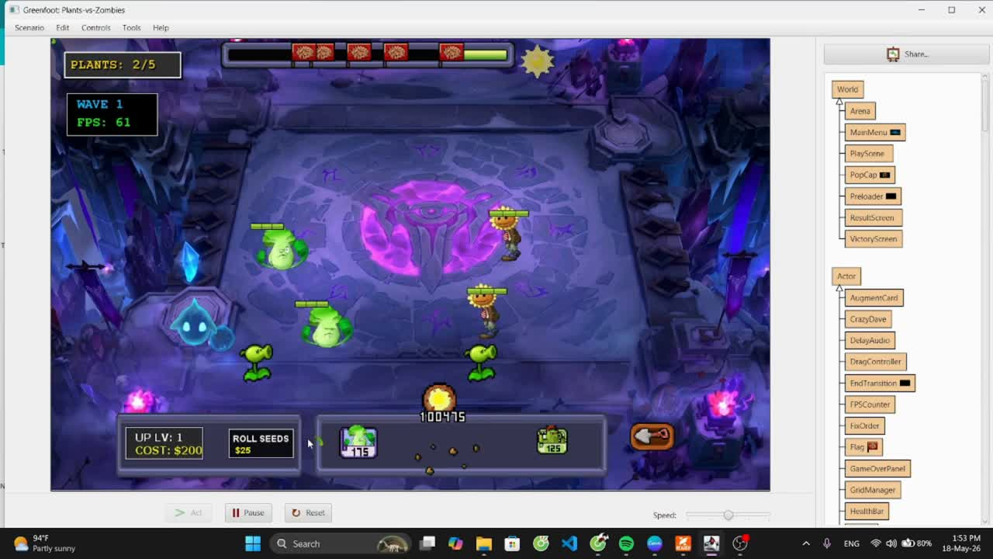

Slide 27
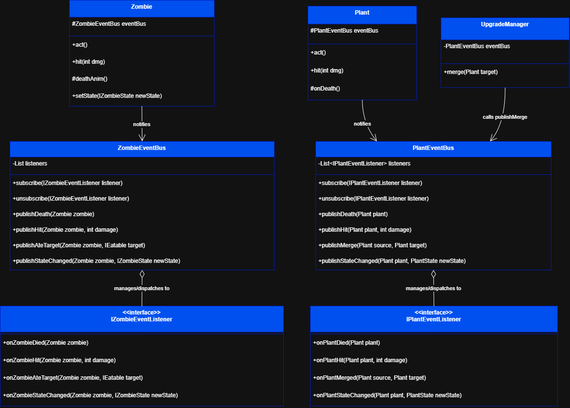
OBSERVER PATTERN

Slide 28
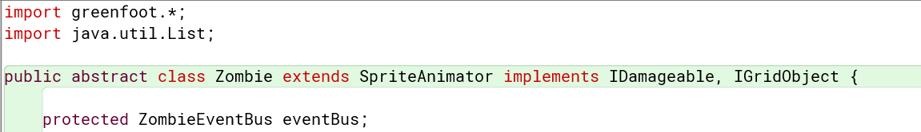
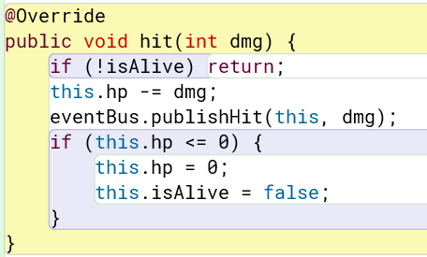
OBSERVER PATTERN

Slide 29
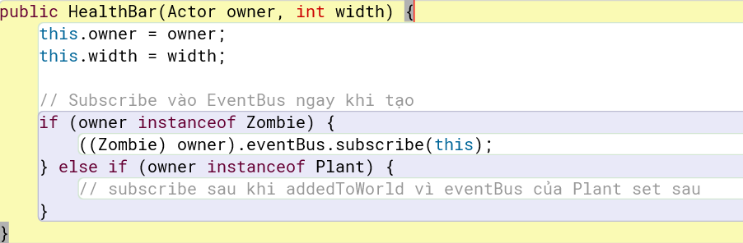

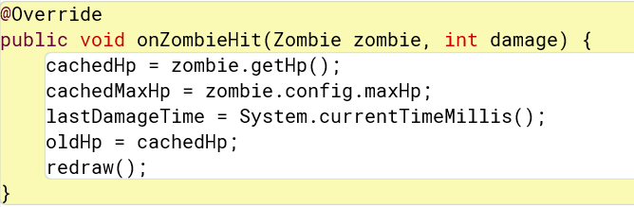

Slide 30
  FACTORY METHOD
  FACADE PATTERN
  FLYWEIGHT PATTERN
  TEMPLATE METHOD
  STATE PATTERN
  STRATEGY PATTERN
  COMMAND PATTERN
  OBSERVER PATTERN

Slide 31



THIS IS THE END. THANKS!!!

